Slide 1
Case – Exploring Electronic Health Records

Slide 2
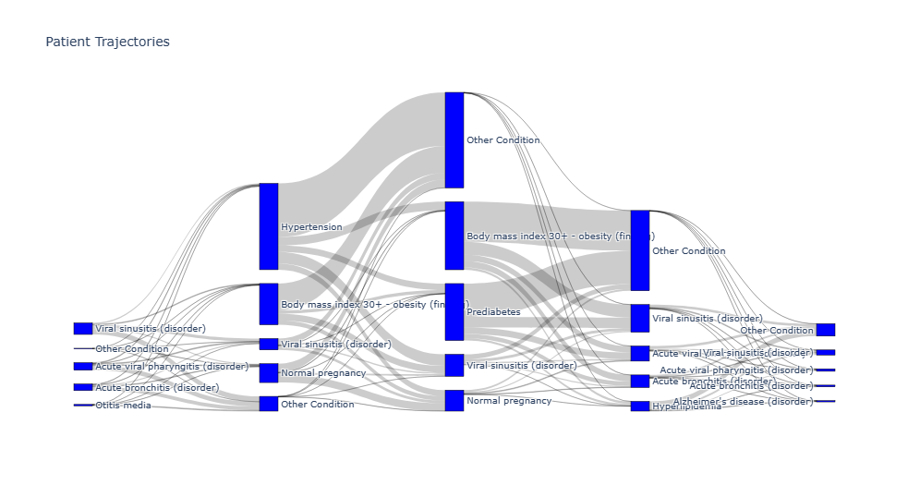
Sankey Diagram

Slide 3
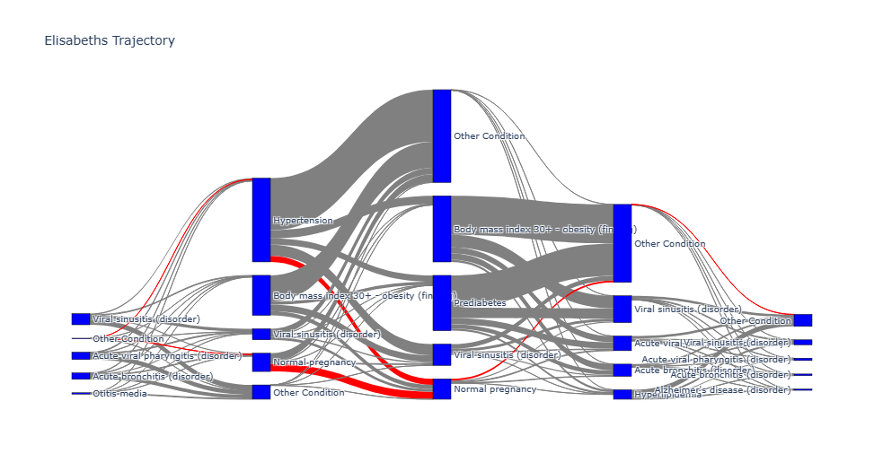
Single Patient Trajectory

Slide 4
Analysing most common conditions
First approach:
Count occurences in conditions dataset
Problem: Some of the most conditions were rare in the medications dataset and was going to make other comparisons hard
Second approach:
Count occurences in medications dataset
Problem: Biased towards conditions with many revisits
Final approach:
Most common condition in medications dataset
Not counting patients returning for the same condition AND given the same medecine. I decided that this could be viewed as a revisit and not a new occurence of the condition.

Slide 5
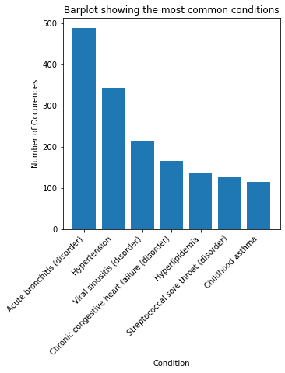
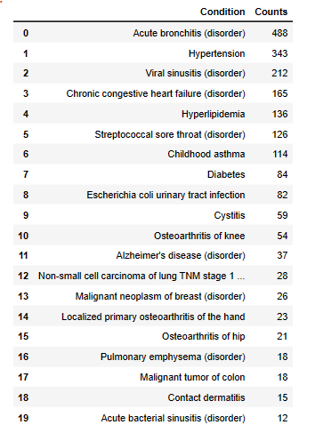
Results

Slide 6
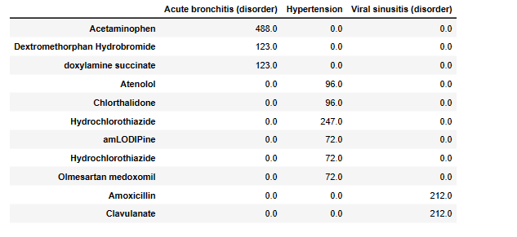
Are there similarities in how the three conditions are treated?

Slide 7
Are there similarities in how the three conditions are treated?
Proposition: Maybe they all have many revisits?
Condition | Revisits
Hypertension | 10195
Diabetes | 6945
Chilhood asthma | 4087
Anemia | 3385
Hyperlipidemia | 2137

Slide 8
What other common pattern characteristics can be found for the three groups of conditions?
Both "Acute bronchitis (disorder)" and "Viral sinusitis (disorder)" is highly correlated with Hypertension
However, this could be due to high frequency
If time had permitted: Normalization

Slide 9
3 Questions
Question 1: Can we use supervised learning to generate suggestion for treatments?
Question 2: Can we use supervised learning to predict the likelihood of a disease in the future for a patient? And if so, can we help to proactively decrease this likelihood?
Question 3: Can we cluster condition to reveal some underlying patterns or even mechanisms of action?

Slide 10
Thank you

